Slide 1
4 Ways to Prevent Code Abuse
Michael L Perry

Slide 2

Michael L Perry
qedcode.com
@MichaelLPerry

Slide 3
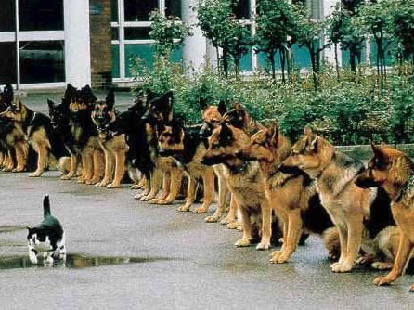
Confidence
Notes:
http://www.globalnerdy.com/2007/02/06/living-dangerously-with-vista-itunes-and-the-ipod/

Slide 4
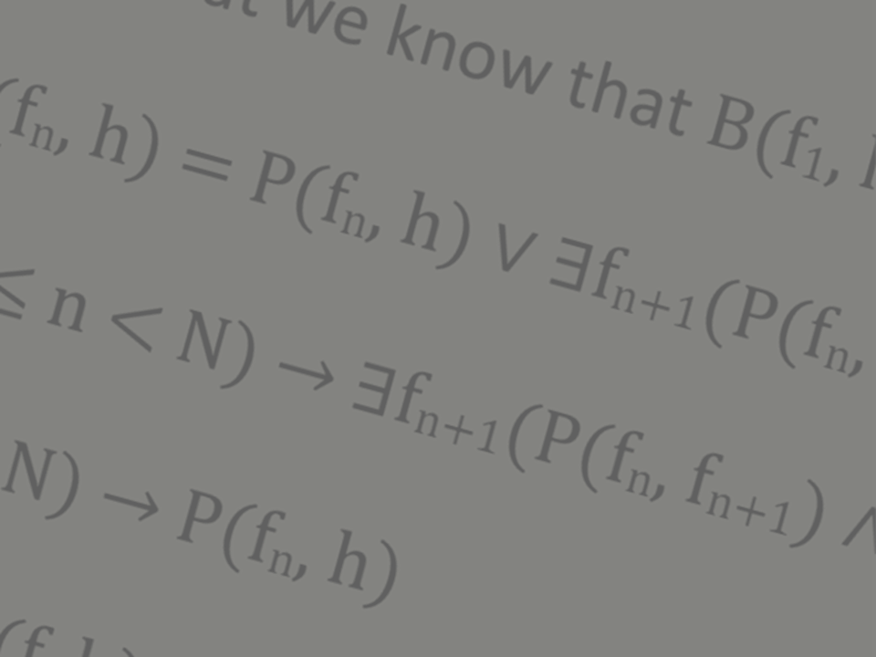
Mathematical Proof

Slide 5
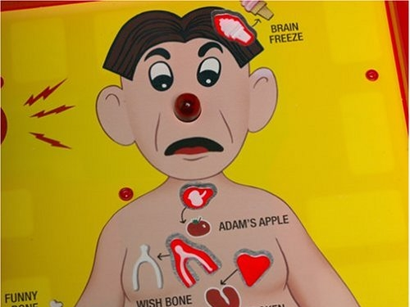
Exceptions
Notes:
http://aroundthesphere.wordpress.com/2009/07/14/organs-urgency-money-and-reform/

Slide 6
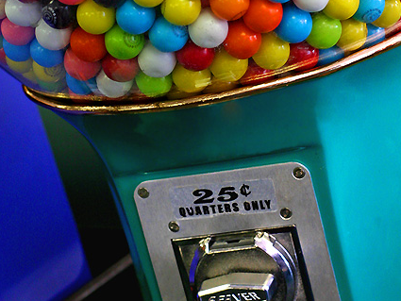
Parameters
Notes:
http://michaelweinberg.com/5new-hitparade1.html

Slide 7

Callbacks
Notes:
http://www.visitingdc.com/city/hollywood-sign-address.asp

Slide 8
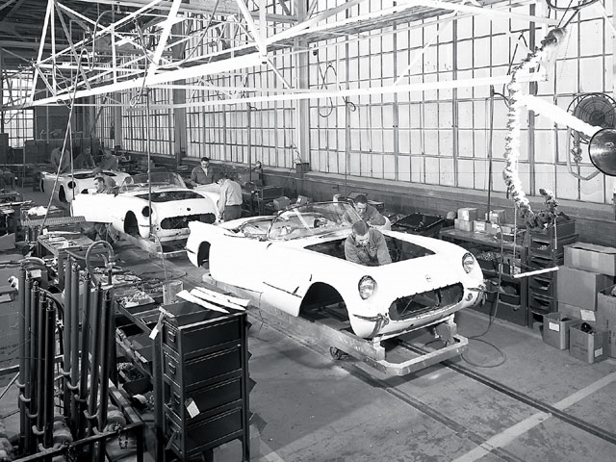
Factories

Slide 9
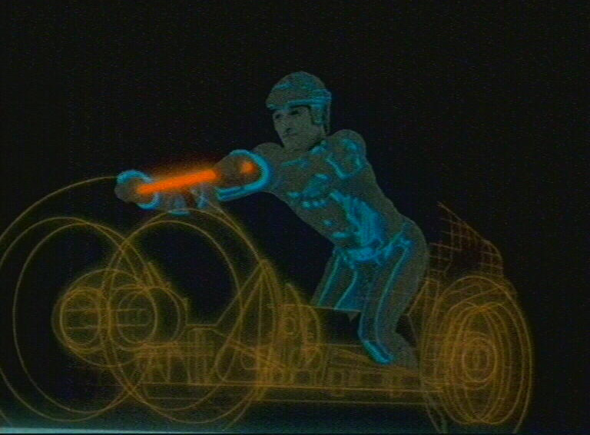
Constructors
Notes:
http://www.virtualworldlets.net/Resources/Hosted/Resource.php?Name=Lightcycles
Copyright Walt Disney

Slide 10
Methods of the Socket class
Socket(SocketInformation si);
Socket(AddressFamily af, SocketType st, ProtocolType pt);
Socket Accept();
void Bind(EndPoint local);
void Connect(EndPoint remote);
void Connect(string host, int port);
void Dispose();
void Listen(int backlog);
int Receive(byte[] buffer);
int Send(byte[] buffer);

Slide 11
Rules of the Socket class
You cannot use a Socket returned from Accept to accept any additional connections from the connection queue.
You cannot call Accept, Bind, Connect, Listen, Receive, or Send if the socket has been closed.
You must call Bind before you can call the Listen method.
You must call Listen before calling Accept.
Connect(string host, int port) can only be called if addressFamily is either InterNetwork or InterNetworkV6.
Connect cannot be called if Listen has been called.
You have to either call Connect or Accept before Sending and Receiving data.
If the socket has been previously disconnected, then you cannot use Connect to restore the connection.

Slide 12
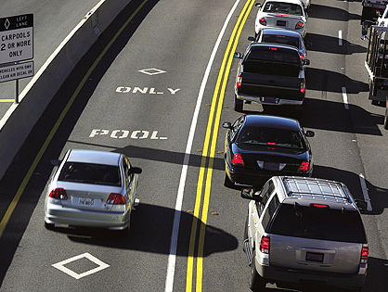
Paradox of Constraints

Slide 13

Provable Code
June 20

Slide 14
Michael L Perry
qedcode.com
@MichaelLPerry

